Slide 1
Bible Reading
Exodus 14:10-16

Slide 2
(1) The Red Sea Route

Slide 3
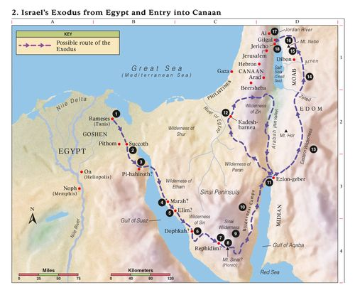

Slide 4
(1) The Red Sea Route
God did not take them on a straight route because he knew they may go back to Egypt if the face war (Exodus 13:17)
God did not take them on a straight route because it would provoke Pharoah and God will be honoured (Exodus 14:2-4)
(2) The Red Sea Problem
The Israelites were trapped (Exodus 14:10)
The Israelites complained (Exodus 14:11-12)
(3) The Red Sea Parts
Moses and Israel were stuck, he couldn’t go forward, back or to the left or right. The only way he could look is up to God (14:13-14)
The sea departs and the Israelites cross of dry land (14:21)
Pharoah’s army try to pursue afterwards but the waters return (14:28)
In the end God is glorified (14:31)

