Slide 1
Bible Reading
Exodus 17:1-7

Slide 2
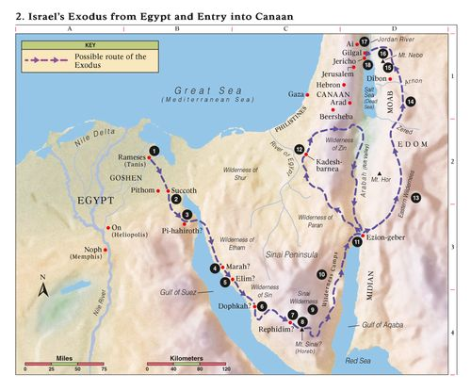

Slide 3
Israel’s stops on the journey are there for our learning (1 Cor 10:1-13)
(2) The source of people’s unbelief
There was no water (17:1, Psalm 81:7, 95:8-9)
What was God’s response
Provided water out of the rock

